Slide 1
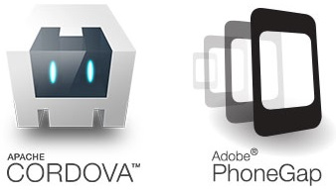
Training
Phone Gap / Cordova
06/08/2014
By S.D.C.O
Team : Web & Mobile Framework

Slide 2
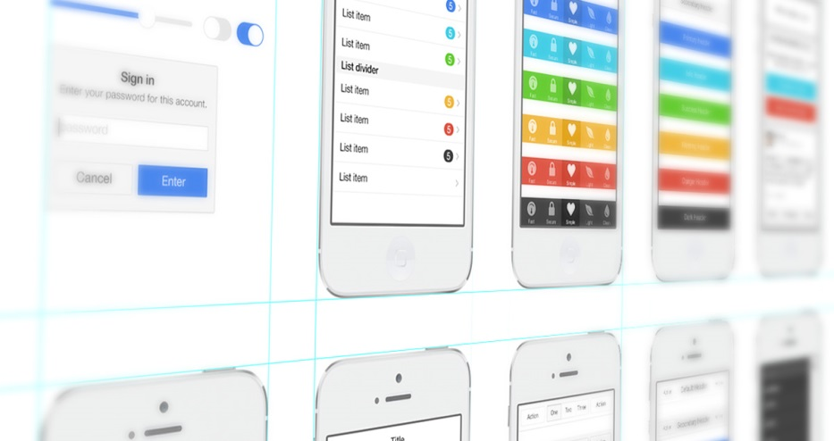
I. About Information
Before please install on your computer :
IDE (WebStrom : http://www.jetbrains.com/webstorm/)
Eclipse ADT (http://developer.android.com/sdk/index.html)
NodeJS : (http://nodejs.org)
Ant : (http://ant.apache.org/bindownload.cgi)
Suject : Develop mobile App with Cordova
Time : One day
Technology :
HTML5
CSS3
JavaScript
Android – IOS
Prerequisites :
Knowledge JavaScript (Framework AngularJS), HTML5 and CSS3.
Basic concepts in Android and IOS
Have a running Android device (real device or emulator)
2/43
Notes:
1. The first idea that one has when it comes to batch processing is that the processing does not need human interaction.
2. Nothing is waiting until processing end, so we say it is not in real-time
3. The processing involves (generaly) a high volume of informations that involve thousands, hundreds of thousands, or millions of data rows or transactions
4. And there may be complex logic or calculations to perform on the datas
5. So, this processing is computationally expensive, and we don't want this cost to be part of our on-line application
6. We apply the same treatement to all of our data, so it is bulk-oriented
7. As soon as we found in this kind of situation, we decided to run as batch process.
8. Later we will see that these characteristics have a strong impact on the approach we have on the treatment of batches

Slide 3
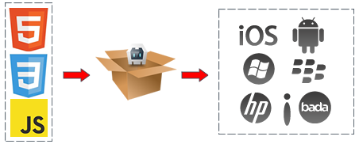
I. What is Phone Gap / Cordova
“PhoneGap is a free and open source framework that allows you to create mobile apps using standardized web APIs for the platforms you care about.”
PhoneGap/Cordova create a Mobile App with
HTML 5
CSS 3
JavaScript
Plugin (GPS, Camera..)
PhoneGap/Cordova create a natif app who open a WebPage inside application
3/43
Notes:
1. The first idea that one has when it comes to batch processing is that the processing does not need human interaction.
2. Nothing is waiting until processing end, so we say it is not in real-time
3. The processing involves (generaly) a high volume of informations that involve thousands, hundreds of thousands, or millions of data rows or transactions
4. And there may be complex logic or calculations to perform on the datas
5. So, this processing is computationally expensive, and we don't want this cost to be part of our on-line application
6. We apply the same treatement to all of our data, so it is bulk-oriented
7. As soon as we found in this kind of situation, we decided to run as batch process.
8. Later we will see that these characteristics have a strong impact on the approach we have on the treatment of batches

Slide 4


I. Difference between Phone Gap and Cordova
2009 : Open Source Project by Nitobi Software (Start-up creates rich web applications and developer toolkits in Ajax and JavaScript)
2011 : Acquisition by Adobe
Open source kernel has been given to Apache Software Foundation
Cordova is a « Community version »
and
Phone Gap is a « Cordova + Enterprise tools »
4/43
Notes:
1. The first idea that one has when it comes to batch processing is that the processing does not need human interaction.
2. Nothing is waiting until processing end, so we say it is not in real-time
3. The processing involves (generaly) a high volume of informations that involve thousands, hundreds of thousands, or millions of data rows or transactions
4. And there may be complex logic or calculations to perform on the datas
5. So, this processing is computationally expensive, and we don't want this cost to be part of our on-line application
6. We apply the same treatement to all of our data, so it is bulk-oriented
7. As soon as we found in this kind of situation, we decided to run as batch process.
8. Later we will see that these characteristics have a strong impact on the approach we have on the treatment of batches

Slide 5


I. What is Phone Gap / Cordova
Platforms :
Amazon Fire OS
Android
BlackBerry 10
FireFox OS
iOS
Ubuntu OS
Windows Phone
Windows 8
Tizen
5/43
Notes:
1. The first idea that one has when it comes to batch processing is that the processing does not need human interaction.
2. Nothing is waiting until processing end, so we say it is not in real-time
3. The processing involves (generaly) a high volume of informations that involve thousands, hundreds of thousands, or millions of data rows or transactions
4. And there may be complex logic or calculations to perform on the datas
5. So, this processing is computationally expensive, and we don't want this cost to be part of our on-line application
6. We apply the same treatement to all of our data, so it is bulk-oriented
7. As soon as we found in this kind of situation, we decided to run as batch process.
8. Later we will see that these characteristics have a strong impact on the approach we have on the treatment of batches

Slide 6
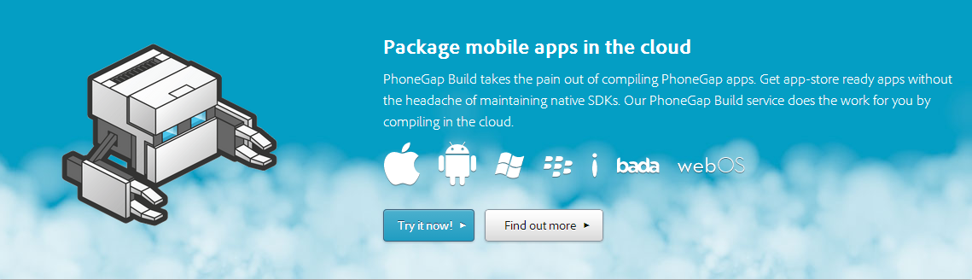
I. Phone Gap Enterprise
Adobe : Phone Gap Build
Build automatic your code for Android, IOS or Windows Phone… on the cloud
https://build.phonegap.com/
6/43
Notes:
1. The first idea that one has when it comes to batch processing is that the processing does not need human interaction.
2. Nothing is waiting until processing end, so we say it is not in real-time
3. The processing involves (generaly) a high volume of informations that involve thousands, hundreds of thousands, or millions of data rows or transactions
4. And there may be complex logic or calculations to perform on the datas
5. So, this processing is computationally expensive, and we don't want this cost to be part of our on-line application
6. We apply the same treatement to all of our data, so it is bulk-oriented
7. As soon as we found in this kind of situation, we decided to run as batch process.
8. Later we will see that these characteristics have a strong impact on the approach we have on the treatment of batches

Slide 7
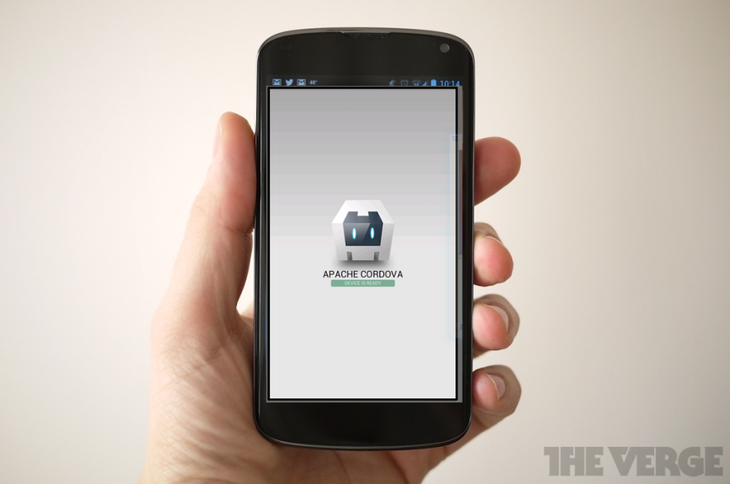
I. Cordova Example
Create projet
cordova create hello com.example.hello Helloworld
Creating a new cordova project with name "Helloworld" and id "com.example.hello" at location "/home/gens/mydev/hello"
Downloading cordova library for www...
Add platform
cordova platform add android
Downloading cordova library for android...
Download complete
Build APK ( or IPA… ) and launch
cordova build android
cordova run android
For a first automatic build, you can see that
7/43
Notes:
1. The first idea that one has when it comes to batch processing is that the processing does not need human interaction.
2. Nothing is waiting until processing end, so we say it is not in real-time
3. The processing involves (generaly) a high volume of informations that involve thousands, hundreds of thousands, or millions of data rows or transactions
4. And there may be complex logic or calculations to perform on the datas
5. So, this processing is computationally expensive, and we don't want this cost to be part of our on-line application
6. We apply the same treatement to all of our data, so it is bulk-oriented
7. As soon as we found in this kind of situation, we decided to run as batch process.
8. Later we will see that these characteristics have a strong impact on the approach we have on the treatment of batches

Slide 8

II. Working Environment
Installation
NodeJS proxy
npm config set proxy http://proxy:3128
npm config set https-proxy http://proxy:3128
Node JS : http://nodejs.org/
Sdk Android : http://developer.android.com/sdk/index.html#download or Android ADT : Bundle http://developer.android.com/sdk/index.html
Ant : http://ant.apache.org/bindownload.cgi
Run
npm install -g cordova
-g : for global installation in your computer
SDK Android
Java : Add « /bin » (in directory of JDK) to Environnement Path (JAVA_HOME)
Android : Add « /tools » and « /platform-tools » (in directory to sdk Android) to Path (ANDROID_HOME)
Ant : Add ant directory to Path (ANT_HOME)
Test in shell with « android » « java » « ant »
If it works = it’s ok. Restart console
SDK iOS
Launch « Xcode ». Ios librairy automatic installation
8/43
Notes:
1. The first idea that one has when it comes to batch processing is that the processing does not need human interaction.
2. Nothing is waiting until processing end, so we say it is not in real-time
3. The processing involves (generaly) a high volume of informations that involve thousands, hundreds of thousands, or millions of data rows or transactions
4. And there may be complex logic or calculations to perform on the datas
5. So, this processing is computationally expensive, and we don't want this cost to be part of our on-line application
6. We apply the same treatement to all of our data, so it is bulk-oriented
7. As soon as we found in this kind of situation, we decided to run as batch process.
8. Later we will see that these characteristics have a strong impact on the approach we have on the treatment of batches

Slide 9

II. Working Environment
Start and structure project
Start a projet
cordova create MonProjet com.atos.hello HelloWorld
Creating a new cordova project with name "HelloWorld" and id "com.atos.hello" at location "/home/gens/mydev/MonProjet"
Downloading cordova library for www...
Folder structure
Hooks : To store a custom command for cordova
Merges : folder merge with www, example : specific css for android or ios
Platforms: Build for Android, Ios, Windows phone
Plugins : plugins added for your application
www : code html – css – javascript – picture etc
Config.xml : Configuration file for your app (fullscreen, version number etc)
9/43
Notes:
1. The first idea that one has when it comes to batch processing is that the processing does not need human interaction.
2. Nothing is waiting until processing end, so we say it is not in real-time
3. The processing involves (generaly) a high volume of informations that involve thousands, hundreds of thousands, or millions of data rows or transactions
4. And there may be complex logic or calculations to perform on the datas
5. So, this processing is computationally expensive, and we don't want this cost to be part of our on-line application
6. We apply the same treatement to all of our data, so it is bulk-oriented
7. As soon as we found in this kind of situation, we decided to run as batch process.
8. Later we will see that these characteristics have a strong impact on the approach we have on the treatment of batches

Slide 10
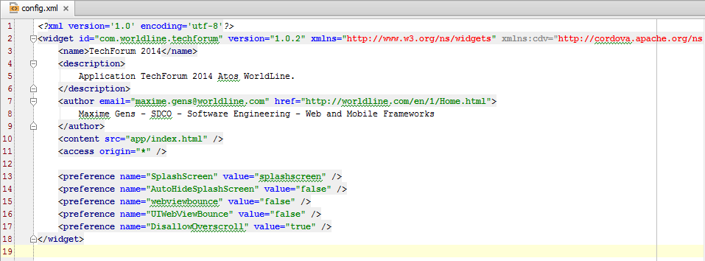
II. Working Environment
Config.xml
Very Important file– Cordova don’t work without this file
Plugins configuration
Application configuration : app name - app version
Ofen modify for each platform (Android – Ios)
10/43
Notes:
1. The first idea that one has when it comes to batch processing is that the processing does not need human interaction.
2. Nothing is waiting until processing end, so we say it is not in real-time
3. The processing involves (generaly) a high volume of informations that involve thousands, hundreds of thousands, or millions of data rows or transactions
4. And there may be complex logic or calculations to perform on the datas
5. So, this processing is computationally expensive, and we don't want this cost to be part of our on-line application
6. We apply the same treatement to all of our data, so it is bulk-oriented
7. As soon as we found in this kind of situation, we decided to run as batch process.
8. Later we will see that these characteristics have a strong impact on the approach we have on the treatment of batches

Slide 11
II. Working Environment
Localhost server
If you want to work locally
Use NodeJS server
Run
D:\MonHelloWorld\www> npm init
Add in package.json
/** * Node server for Worldline TechForum 2014 */
var express = require('express');
var app = express();
var maxAge = 31557600000;
app.use(express.compress());
app.use(express.bodyParser());
app.use(express.methodOverride());
app.use(express.static(__dirname + '/' ));
app.get('/*', function(req,res){
res.sendfile(__dirname + '/index.html'); });
app.listen(3000);
console.log('Listening on port 3000');
"devDependencies": {
"express": "^3.4.8",
"karma": "^0.12.16"
}
Run
D:\MonHelloWorld\www> npm install
Launch NodeJS server : « node server.js »
D:\MonHelloWorld\www> node server.js
Connect.multipart() will be removed in connect 3.0
Listening on port 3000
Example server.js
11/43

Slide 12
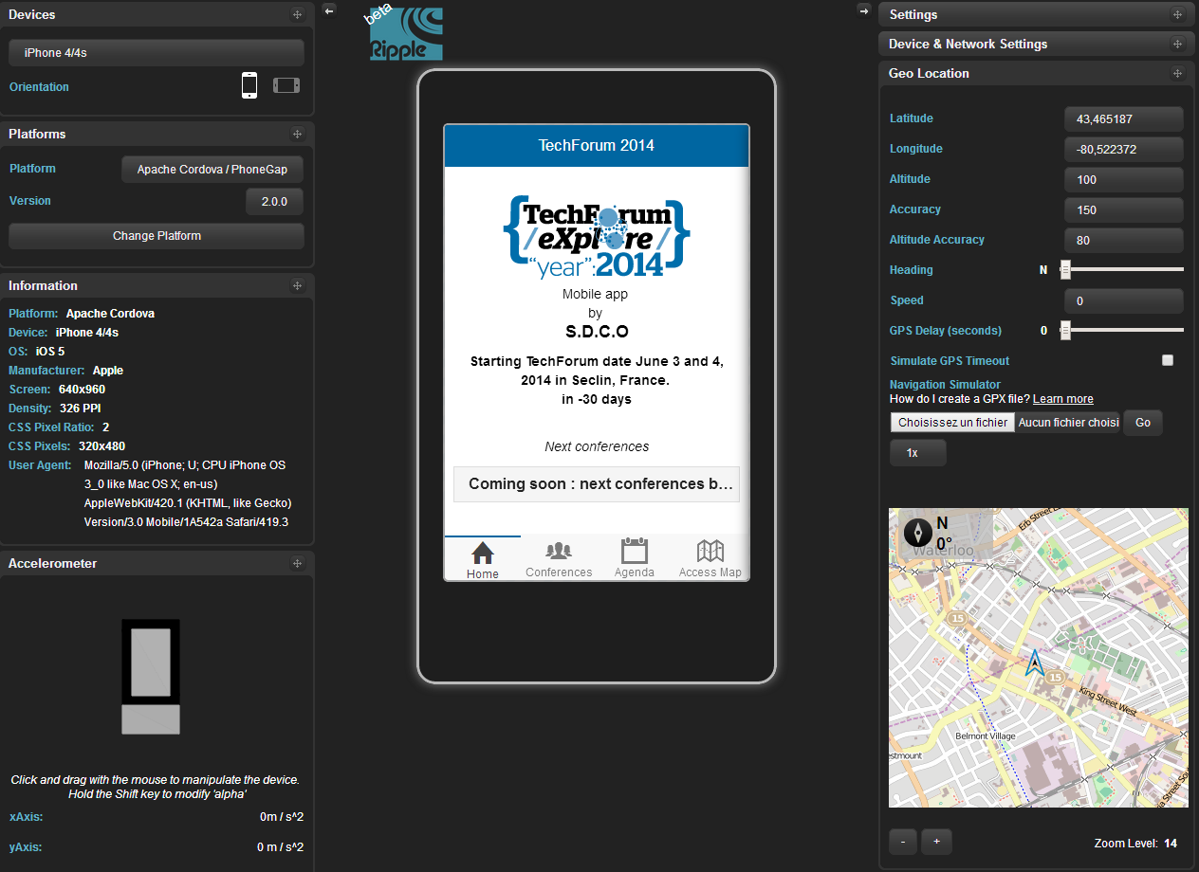
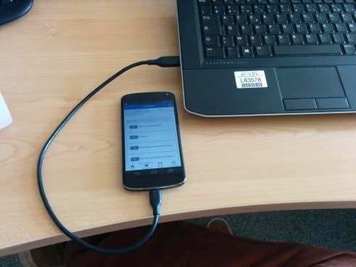
II. Working Environment
How to launch you app
Ripple emultor :
Google Chrome extension
Emule a device environnement
Mainly for visual performance
Old and not updated
A real device
Need a build
Android Emulator
Need a build
The best choice :
Use a real device
Ripple
https://chrome.google.com/webstore/detail/ripple-emulator-beta/geelfhphabnejjhdalkjhgipohgpdnoc
12/43
Notes:
1. The first idea that one has when it comes to batch processing is that the processing does not need human interaction.
2. Nothing is waiting until processing end, so we say it is not in real-time
3. The processing involves (generaly) a high volume of informations that involve thousands, hundreds of thousands, or millions of data rows or transactions
4. And there may be complex logic or calculations to perform on the datas
5. So, this processing is computationally expensive, and we don't want this cost to be part of our on-line application
6. We apply the same treatement to all of our data, so it is bulk-oriented
7. As soon as we found in this kind of situation, we decided to run as batch process.
8. Later we will see that these characteristics have a strong impact on the approach we have on the treatment of batches

Slide 13

III. Cordova Plugins
http://plugins.cordova.io/#/
API plugin Cordova
269 plugins :
Device
Console
File
Network-information
Dialogs
Camera
Splashscreen
Geolocalisation
Globalization
Vibration
StatusBar
…
Use a device native functionnality with cordova
How to call a camera, GPS… in JavaScript
API Plugin
Possible to create your plugins
13/43
Notes:
1. The first idea that one has when it comes to batch processing is that the processing does not need human interaction.
2. Nothing is waiting until processing end, so we say it is not in real-time
3. The processing involves (generaly) a high volume of informations that involve thousands, hundreds of thousands, or millions of data rows or transactions
4. And there may be complex logic or calculations to perform on the datas
5. So, this processing is computationally expensive, and we don't want this cost to be part of our on-line application
6. We apply the same treatement to all of our data, so it is bulk-oriented
7. As soon as we found in this kind of situation, we decided to run as batch process.
8. Later we will see that these characteristics have a strong impact on the approach we have on the treatment of batches

Slide 14
III. Cordova Plugins
Installation plugin
cordova plugin add org.apache.cordova.vibration
Fetching plugin "org.apache.cordova.vibration" via plugin registry
Installing "org.apache.cordova.vibration" for android
You can now use it in your javascript
navigator.notification.vibrate(time)
Consult documentation to use plugin
If you use plugin with worldline proxy
Donwload .zip plugin file on Github. For example
https://github.com/apache/cordova-plugin-splashscreen
https://github.com/apache/cordova-plugin-geolocation
https://github.com/apache/cordova-plugin-network-information
Extracts and install plugins
cordova plugin add [pathtotheextractedplugingit]cordova-plugin-geolocation-master
cordova plugin add [pathtotheextractedplugingit]cordova-plugin-splashscreen-master
14/43
Notes:
1. The first idea that one has when it comes to batch processing is that the processing does not need human interaction.
2. Nothing is waiting until processing end, so we say it is not in real-time
3. The processing involves (generaly) a high volume of informations that involve thousands, hundreds of thousands, or millions of data rows or transactions
4. And there may be complex logic or calculations to perform on the datas
5. So, this processing is computationally expensive, and we don't want this cost to be part of our on-line application
6. We apply the same treatement to all of our data, so it is bulk-oriented
7. As soon as we found in this kind of situation, we decided to run as batch process.
8. Later we will see that these characteristics have a strong impact on the approach we have on the treatment of batches

Slide 15
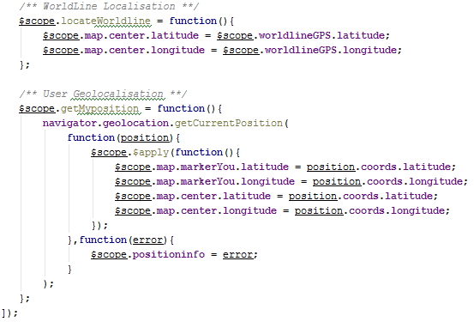
III. Cordova Plugins
Example
https://github.com/apache/cordova-plugin-geolocation/
Cordova GPS Plugin
Demo with AngularJS :
A JavaScript Framework
With AngularJS :
Use a Apply() for update interface
15/43
Notes:
1. The first idea that one has when it comes to batch processing is that the processing does not need human interaction.
2. Nothing is waiting until processing end, so we say it is not in real-time
3. The processing involves (generaly) a high volume of informations that involve thousands, hundreds of thousands, or millions of data rows or transactions
4. And there may be complex logic or calculations to perform on the datas
5. So, this processing is computationally expensive, and we don't want this cost to be part of our on-line application
6. We apply the same treatement to all of our data, so it is bulk-oriented
7. As soon as we found in this kind of situation, we decided to run as batch process.
8. Later we will see that these characteristics have a strong impact on the approach we have on the treatment of batches

Slide 16
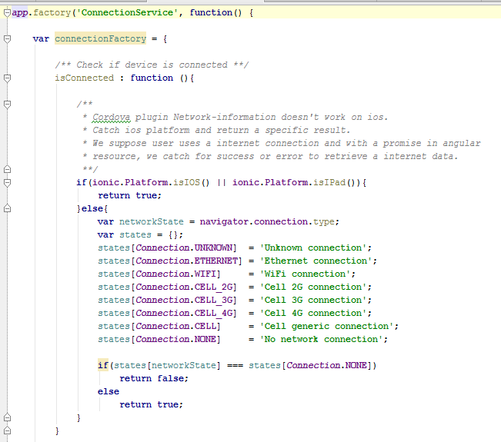
III. Cordova Plugins
Example
https://github.com/apache/cordova-plugin-network-information
Cordova network Information Plugin
Good Practice :
Use a Angular Service to call this fonctionality
Only IOS and
Windows Phone
iOS and Windows Phone can't detect the type of cellular network connection.
16/43
Notes:
1. The first idea that one has when it comes to batch processing is that the processing does not need human interaction.
2. Nothing is waiting until processing end, so we say it is not in real-time
3. The processing involves (generaly) a high volume of informations that involve thousands, hundreds of thousands, or millions of data rows or transactions
4. And there may be complex logic or calculations to perform on the datas
5. So, this processing is computationally expensive, and we don't want this cost to be part of our on-line application
6. We apply the same treatement to all of our data, so it is bulk-oriented
7. As soon as we found in this kind of situation, we decided to run as batch process.
8. Later we will see that these characteristics have a strong impact on the approach we have on the treatment of batches

Slide 17

III. Cordova Plugins
Ng-Cordova
App Ng-Cordova
Cordova with the power of AngularJS
ngCordova is a set of AngularJS extensions on top of the Cordova API to make it easier to build, test, and deploy Cordova apps with AngularJS.
Version Alpha v0.1.3
There not all plugin
Easy to use a simply plugin
Official webSite
http://ngcordova.com/
Demo app by S.D.C.O – Web & Mobile Framework
https://github.com/got5/ngCordova-demo
17/43

Slide 18

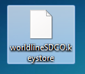

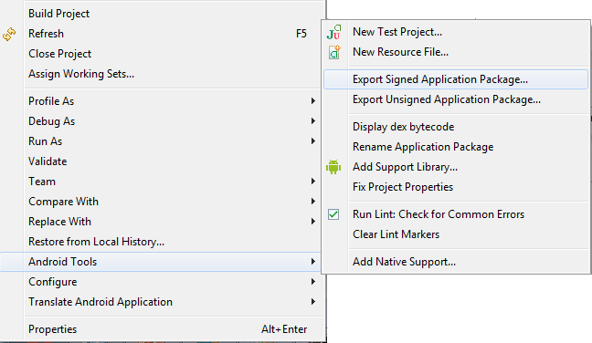
IV. Sign your app
Android
You app should be signed !
KeyStore
Alias of your app
Password of your app
Country
…
worldlineSDCO.keystore
alias
alias
alias
alias
techforum
ng-cordova
app 3
app 4
It’s very easy on Android
Keystore organisation
How to sign a app with Eclipse
Follow indications
Create a keystore
Create a alias
…
18/43
Notes:
1. The first idea that one has when it comes to batch processing is that the processing does not need human interaction.
2. Nothing is waiting until processing end, so we say it is not in real-time
3. The processing involves (generaly) a high volume of informations that involve thousands, hundreds of thousands, or millions of data rows or transactions
4. And there may be complex logic or calculations to perform on the datas
5. So, this processing is computationally expensive, and we don't want this cost to be part of our on-line application
6. We apply the same treatement to all of our data, so it is bulk-oriented
7. As soon as we found in this kind of situation, we decided to run as batch process.
8. Later we will see that these characteristics have a strong impact on the approach we have on the treatment of batches

Slide 19
IV. Sign your app
Android
Generate keystore on command line
D:\A******\>keytool -genkey -alias helloworld -keyalg RSA -keystore worldlineSDCO.keystore -keysize 2048 -validity 10000
Entrez le mot de passe du fichier de clÚs :
Ressaisissez le nouveau mot de passe :
Quels sont vos nom et prÚnom ?
[Unknown]: Maxime Gens
Quel est le nom de votre unitÚ organisationnelle ?
[Unknown]: SDCO - Web and Mobile framework
…………
…………
Est-ce CN=Maxime Gens, OU=SDCO - Web and Mobile framework, O=Wordline, L=Seclin, ST=Nord-Pas-de-Calais, C=fr ?
[non]: oui
Entrez le mot de passe de la clÚ pour <helloworld>
(appuyez sur EntrÚe s'il s'agit du mot de passe du fichier de clÚs) :
1 | keytool -genkey -alias helloworld -keyalg RSA -keystore worldlineSDCO.keystore -keysize 2048 -validity 10000
19/43
Notes:
1. The first idea that one has when it comes to batch processing is that the processing does not need human interaction.
2. Nothing is waiting until processing end, so we say it is not in real-time
3. The processing involves (generaly) a high volume of informations that involve thousands, hundreds of thousands, or millions of data rows or transactions
4. And there may be complex logic or calculations to perform on the datas
5. So, this processing is computationally expensive, and we don't want this cost to be part of our on-line application
6. We apply the same treatement to all of our data, so it is bulk-oriented
7. As soon as we found in this kind of situation, we decided to run as batch process.
8. Later we will see that these characteristics have a strong impact on the approach we have on the treatment of batches

Slide 20
IV. Sign your app
Android
Sign app on commande line
D:\A******\Desktop>jarsigner -verbose -keystore worldlineSDCO.keystore techforum.apk worldlineSDCO
Enter Passphrase for keystore:
…
jar signed.
If you use Java 7
1 | jarsigner -verbose -keystore <name_du_keystore.keystore> <name_apk.apk> <alias>
Else
1 | jarsigner -verbose -sigalg SHA1withRSA -digestalg SHA1 -keystore <name_du_keystore.keystore> <name_apk.apk> <alias>
<name_keystore.keystore> : keystore name use to sign app
<name_apk.apk> : apk name to sign
<alias> : key name in keystore
20/43
Notes:
1. The first idea that one has when it comes to batch processing is that the processing does not need human interaction.
2. Nothing is waiting until processing end, so we say it is not in real-time
3. The processing involves (generaly) a high volume of informations that involve thousands, hundreds of thousands, or millions of data rows or transactions
4. And there may be complex logic or calculations to perform on the datas
5. So, this processing is computationally expensive, and we don't want this cost to be part of our on-line application
6. We apply the same treatement to all of our data, so it is bulk-oriented
7. As soon as we found in this kind of situation, we decided to run as batch process.
8. Later we will see that these characteristics have a strong impact on the approach we have on the treatment of batches

Slide 21


IV. Sign your app
Ios
You have two certificats
Develper Certificat
Test your app
Run a ios simulateur
Run app on real ios device
Distribution Certificate
Sign your app
Publish on Apple Store or In-house Store
Create a official version
Run Official version on all ios device
21/43
Notes:
1. The first idea that one has when it comes to batch processing is that the processing does not need human interaction.
2. Nothing is waiting until processing end, so we say it is not in real-time
3. The processing involves (generaly) a high volume of informations that involve thousands, hundreds of thousands, or millions of data rows or transactions
4. And there may be complex logic or calculations to perform on the datas
5. So, this processing is computationally expensive, and we don't want this cost to be part of our on-line application
6. We apply the same treatement to all of our data, so it is bulk-oriented
7. As soon as we found in this kind of situation, we decided to run as batch process.
8. Later we will see that these characteristics have a strong impact on the approach we have on the treatment of batches

Slide 22
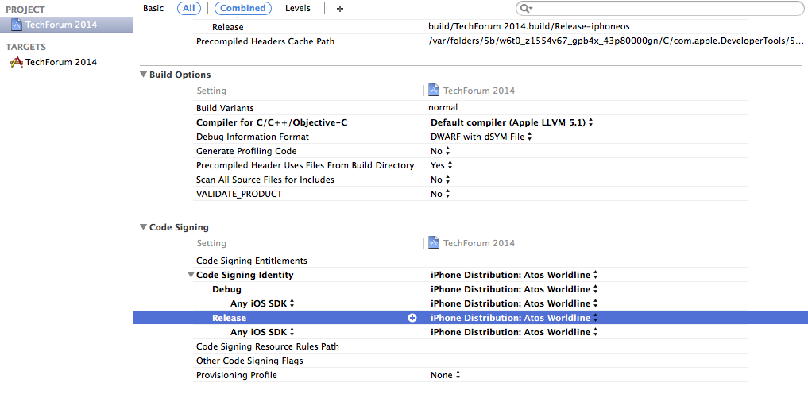
IV. Sign your app
Ios
How to sign with distribution Certificate
Select your production certificate on your project : « Build Settings » and « Code signing »
22/43
Notes:
1. The first idea that one has when it comes to batch processing is that the processing does not need human interaction.
2. Nothing is waiting until processing end, so we say it is not in real-time
3. The processing involves (generaly) a high volume of informations that involve thousands, hundreds of thousands, or millions of data rows or transactions
4. And there may be complex logic or calculations to perform on the datas
5. So, this processing is computationally expensive, and we don't want this cost to be part of our on-line application
6. We apply the same treatement to all of our data, so it is bulk-oriented
7. As soon as we found in this kind of situation, we decided to run as batch process.
8. Later we will see that these characteristics have a strong impact on the approach we have on the treatment of batches

Slide 23
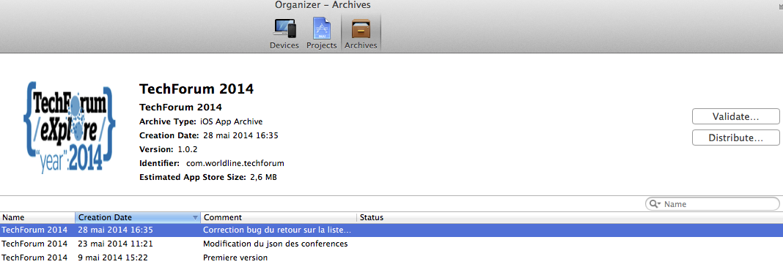
IV. Sign your app
Ios
Generate a « archive » by « Product »
In « Windows » select « organiser » and « Distribute » on your app for create a IPA
IPA is your binary application ( like APK on Android)
23/43
Notes:
1. The first idea that one has when it comes to batch processing is that the processing does not need human interaction.
2. Nothing is waiting until processing end, so we say it is not in real-time
3. The processing involves (generaly) a high volume of informations that involve thousands, hundreds of thousands, or millions of data rows or transactions
4. And there may be complex logic or calculations to perform on the datas
5. So, this processing is computationally expensive, and we don't want this cost to be part of our on-line application
6. We apply the same treatement to all of our data, so it is bulk-oriented
7. As soon as we found in this kind of situation, we decided to run as batch process.
8. Later we will see that these characteristics have a strong impact on the approach we have on the treatment of batches

Slide 24
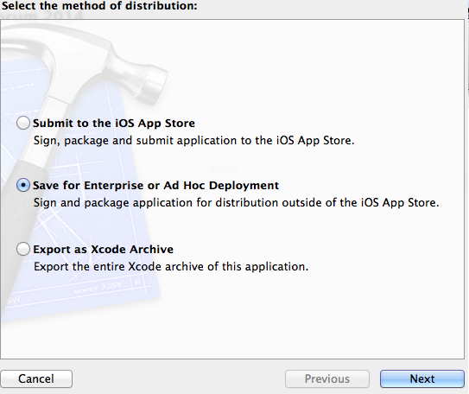
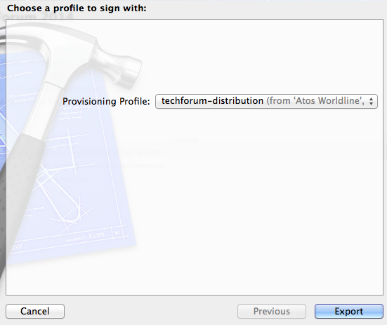

IV. Sign your app
Ios
Select your method of distribution
Selection your profile
You have now generate IPA
24/43
Notes:
1. The first idea that one has when it comes to batch processing is that the processing does not need human interaction.
2. Nothing is waiting until processing end, so we say it is not in real-time
3. The processing involves (generaly) a high volume of informations that involve thousands, hundreds of thousands, or millions of data rows or transactions
4. And there may be complex logic or calculations to perform on the datas
5. So, this processing is computationally expensive, and we don't want this cost to be part of our on-line application
6. We apply the same treatement to all of our data, so it is bulk-oriented
7. As soon as we found in this kind of situation, we decided to run as batch process.
8. Later we will see that these characteristics have a strong impact on the approach we have on the treatment of batches

Slide 25
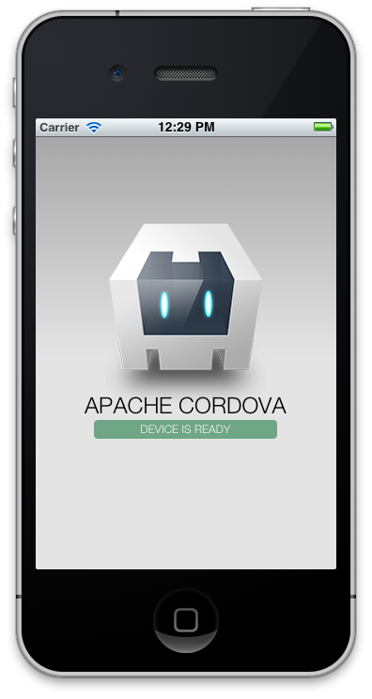


V. Exercice : Hello World
Steps :
Create a cordova project
Add platform (Android – Ios …)
Build
Run (Open android project with eclipse and run emulator or « cordova run »)
Sign
You can see
On real device (or emulator)
On localhost
25/43
Notes:
1. The first idea that one has when it comes to batch processing is that the processing does not need human interaction.
2. Nothing is waiting until processing end, so we say it is not in real-time
3. The processing involves (generaly) a high volume of informations that involve thousands, hundreds of thousands, or millions of data rows or transactions
4. And there may be complex logic or calculations to perform on the datas
5. So, this processing is computationally expensive, and we don't want this cost to be part of our on-line application
6. We apply the same treatement to all of our data, so it is bulk-oriented
7. As soon as we found in this kind of situation, we decided to run as batch process.
8. Later we will see that these characteristics have a strong impact on the approach we have on the treatment of batches

Slide 26
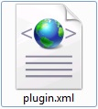


V. Exercice : Create a plugin
Step by step
Create a plugin to send a sms
There are tree files in cordova plugin
Content information to make a link with Java and JavaScript
Natid code for Android
JavaScript File with function to call natif code

Slide 27
V. Create a plugin
Plugin.xml
<plugin xmlns="http://apache.org/cordova/ns/plugins/1.0"
xmlns:android="http://schemas.android.com/apk/res/android"
id="com.phonegap.plugins.sms"
version="0.1.0">
<name>SMSPlugin</name>
<js-module src="www/sms.js" name="SMSPlugin">
<clobbers target="sms" />
</js-module>
Package name of your java application
Plugin name
<js-module> Module definition :
src : path to javascript module
clobbers : Javascript objet name.
For example, in your code, you call sms.myfunction to use your plugin

Slide 28
V. Create a plugin
Plugin.xml
<platform> attribut
<platform name="android">
<source-file src="src/android/SMSPlugin.java" target-dir="src/com/phonegap/plugins/sms"/>
<config-file target="res/xml/config.xml" parent="plugins">
<plugin name="SMSPlugin" value="com.phonegap.plugins.sms.SMSPlugin" />
<feature name="SMSPlugin">
<param name="android-package" value="com.phonegap.plugins.sms.SMSPlugin" />
</feature>
</config-file>
<config-file target="AndroidManifest.xml" parent="/manifest">
<uses-permission android:name="android.permission.SEND_SMS" />
</config-file>
</platform>
Platform name
<source-file>
src : link to java file
Target-dir : path inside include java file
<config-file>
Add permission in Android Manifest
<config-file>
Src : file path which inside add element
Add element in config.xml
Plugin reference and feature reference

Slide 29
V. Create a plugin
File sms.js
You must create a Javascript objet with prototype
/** Retreive objet for execute JAVA function from JS**/
var exec = require('cordova/exec');
var SMS = function(){};
SMS.prototype.send = function(number, message, success, error) {
var args = [number, message];
exec(success, error, "SMSPlugin", "send", args);
}
/** Export objet to use it !**/
module.exports = new SMS();
Function exec
First param : success callback
Second param : error callback
Third param : Java class name
Fourth param : action name to execute
Fifth param : argument for JAVA function
Don’t forget to export object to use it !!

Slide 30
V. Create a plugin
SMSPlugin.java
It’s now a Android class
Import
Code
package com.phonegap.plugins.sms;
import org.json.JSONArray;
import org.json.JSONException;
import org.json.JSONObject;
import android.app.Activity;
import android.content.Intent;
import android.util.Log;
import org.apache.cordova.CordovaPlugin;
import org.apache.cordova.CallbackContext;
import org.apache.cordova.PluginResult;
public class SMSPlugin extends CordovaPlugin {
public boolean execute(String action, JSONArray args, final CallbackContext callbackContext){
if("send".equals(action)) {
try{
SmsManager smsManager = SmsManager.getDefault();
String phoneNumber = args.getString(0);
String message = args.getString(1);
smsManager.sendTextMessage(phoneNumber, null, message, null, null);
callbackContext.success("SMS sent");
return true;
}catch(Exception e) {
callbackContext.error("SMS failed");
}
}
return false;
}
}
Don’t forget
Extends CordovaPlugin
Implement « execute » function
Test a action name
Implement your plugin ;)

Slide 31
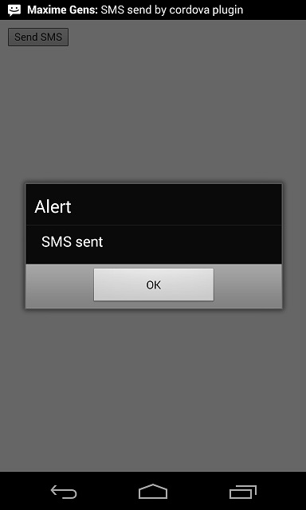
V. Create a plugin
Execute your plugin
You can add into your code
function sendSMS() {
alert(" Envoi du SMS")
sms.send("0622334455", "Hello ce sms a été envoyé via le plugin !", function(success) {
alert(success);
}, function(error) {
alert(error);
});
};
cordova plugin add SMSPlugin
Cordova build android
Cordova run android
You can call this function by a button and test in your device
« You can test with a new project cordova and a basique button to call a plugin »

Slide 32
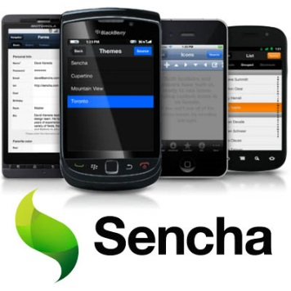


VI. Mobile JavaScript Framework
Sencha Touch
Launch v 1.0 in 2010
HTML5 - JavaScript
MVC – Objet (Like .NET and framework Java)
Popular and used by several big enterprises
More than 1 million users
Leader
Famo.us
New on markethttp://www.sencha.com/products/touch/
Free and Open-Source
3D UI with HTML5 and CSS3
Hardware acceleration
Ionic
New on market ( October 2013 )
AngularJS – Performance
Composant Javascript
Hight potential
http://www.sencha.com/products/touch/
http://famo.us/
http://ionicframework.com/
32/43
Notes:
1. The first idea that one has when it comes to batch processing is that the processing does not need human interaction.
2. Nothing is waiting until processing end, so we say it is not in real-time
3. The processing involves (generaly) a high volume of informations that involve thousands, hundreds of thousands, or millions of data rows or transactions
4. And there may be complex logic or calculations to perform on the datas
5. So, this processing is computationally expensive, and we don't want this cost to be part of our on-line application
6. We apply the same treatement to all of our data, so it is bulk-oriented
7. As soon as we found in this kind of situation, we decided to run as batch process.
8. Later we will see that these characteristics have a strong impact on the approach we have on the treatment of batches

Slide 33
VII. Ionic
Introduction : make an application with Ionic Framework
33/43
Notes:
1. The first idea that one has when it comes to batch processing is that the processing does not need human interaction.
2. Nothing is waiting until processing end, so we say it is not in real-time
3. The processing involves (generaly) a high volume of informations that involve thousands, hundreds of thousands, or millions of data rows or transactions
4. And there may be complex logic or calculations to perform on the datas
5. So, this processing is computationally expensive, and we don't want this cost to be part of our on-line application
6. We apply the same treatement to all of our data, so it is bulk-oriented
7. As soon as we found in this kind of situation, we decided to run as batch process.
8. Later we will see that these characteristics have a strong impact on the approach we have on the treatment of batches

Slide 34


VII. Introduction Ionic
http://ionicframework.com/
Open source front-end framework for developing hybrid mobile apps with HTML5
Create hydride application with web technology
Use Phone Gap / Cordova
Call a device functionality with API Apache (GPS…)
Web development environment
Framework JavaScript and CSS
Very fast mobile app (high level performance)
Recent Framework
November 2013
Beta version 1.0
Target for device > Android 4.1 and IOS 6
34/43
Notes:
1. The first idea that one has when it comes to batch processing is that the processing does not need human interaction.
2. Nothing is waiting until processing end, so we say it is not in real-time
3. The processing involves (generaly) a high volume of informations that involve thousands, hundreds of thousands, or millions of data rows or transactions
4. And there may be complex logic or calculations to perform on the datas
5. So, this processing is computationally expensive, and we don't want this cost to be part of our on-line application
6. We apply the same treatement to all of our data, so it is bulk-oriented
7. As soon as we found in this kind of situation, we decided to run as batch process.
8. Later we will see that these characteristics have a strong impact on the approach we have on the treatment of batches

Slide 35

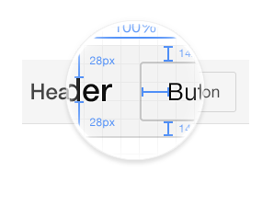


VII. Introduction Ionic
Ionic Objectives
Performance Obsession
Optimized for Angular JS
Pleasant and modern design
Very potential framework
Active forum
Angular is a JavaScript Framework developed by Google
Link
http://ionicframework.com/docs/
http://codepen.io/ionic/
http://ionicons.com/
35/43
Notes:
1. The first idea that one has when it comes to batch processing is that the processing does not need human interaction.
2. Nothing is waiting until processing end, so we say it is not in real-time
3. The processing involves (generaly) a high volume of informations that involve thousands, hundreds of thousands, or millions of data rows or transactions
4. And there may be complex logic or calculations to perform on the datas
5. So, this processing is computationally expensive, and we don't want this cost to be part of our on-line application
6. We apply the same treatement to all of our data, so it is bulk-oriented
7. As soon as we found in this kind of situation, we decided to run as batch process.
8. Later we will see that these characteristics have a strong impact on the approach we have on the treatment of batches

Slide 36

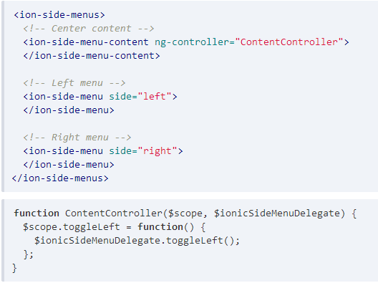
VII. Demonstration Ionic
SlideMenu
36/43

Slide 37

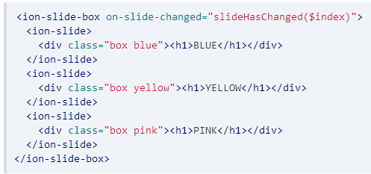
VII. Demonstration Ionic
Slidebox
37/43

Slide 38

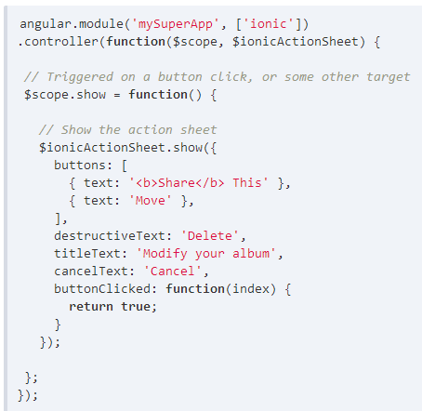
VII. Demonstration Ionic
ActionSheet
38/43

Slide 39
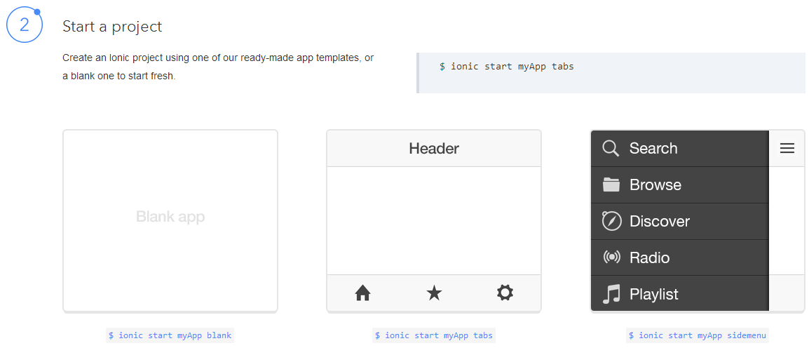
VII. Demonstration Ionic
Start a Ionic project
Install Ionic with « npm install –g ionic »
39/43

Slide 40
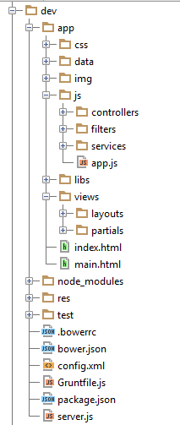
VII. Working Environment
www folder content
HTML
CSS
JavaScript
Test
Ressources
Config file (Bower, Grunt, NodeJS…)
It’s a SPA application
PhoneGap Hack
Sinple Page Application Principle
Web app with a unique page
Web Page build dunamically
40/43
Notes:
1. The first idea that one has when it comes to batch processing is that the processing does not need human interaction.
2. Nothing is waiting until processing end, so we say it is not in real-time
3. The processing involves (generaly) a high volume of informations that involve thousands, hundreds of thousands, or millions of data rows or transactions
4. And there may be complex logic or calculations to perform on the datas
5. So, this processing is computationally expensive, and we don't want this cost to be part of our on-line application
6. We apply the same treatement to all of our data, so it is bulk-oriented
7. As soon as we found in this kind of situation, we decided to run as batch process.
8. Later we will see that these characteristics have a strong impact on the approach we have on the treatment of batches

Slide 41
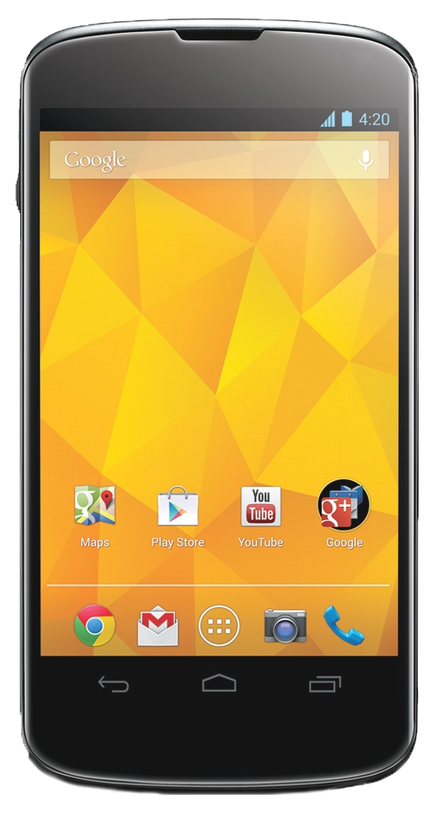

VIII. TechForum eXplore 2014 App
Mobile app for Techforum 2014 event in Worldline
Cordova app build with Ionic framework ( version beta 1.0-4)
To do in the next slides
Import and install Ionic with bower
Create Ion-Tab
Implement conferences list with ion-list
Implement Popup and loader with IonicPopup, ionicLoading
Integration GPS Plugin
Deploy on Android
Technology and utils
Ionic
Cordova Plugin (GPS, Network Information, SplashScreen )
HTML5 - CSS3 – AngularJS
Bower – Grunt
NodeJS
Ripple – Nexus 4 device
PhotoFiltre
41/43
Notes:
1. The first idea that one has when it comes to batch processing is that the processing does not need human interaction.
2. Nothing is waiting until processing end, so we say it is not in real-time
3. The processing involves (generaly) a high volume of informations that involve thousands, hundreds of thousands, or millions of data rows or transactions
4. And there may be complex logic or calculations to perform on the datas
5. So, this processing is computationally expensive, and we don't want this cost to be part of our on-line application
6. We apply the same treatement to all of our data, so it is bulk-oriented
7. As soon as we found in this kind of situation, we decided to run as batch process.
8. Later we will see that these characteristics have a strong impact on the approach we have on the treatment of batches

Slide 42

IIX. Application Advancement
Import and install Ionic with bower
D:\A******\MonProjet >npm install
Install Bower ( npm install –g bower)
D:\A******\MonProjet >npm intstall –g bower
D:\A******\MonProjet >bower init
Create a .bowerrc and add a code following
{
"directory": "app/libs",
"json": "bower.json"
}
Install with bower
Ionic ( 1.0.0-beta.4)
angular-resource (1.2.20)
angular-google-maps (1.0.17)
D:\A******\MonProjet >bower install ionic#1.0.0-beta.4 --save
Include in main.html
<!-- Ionic -->
<link rel="stylesheet" href="libs/ionic/release/css/ionic.min.css">
<script src="libs/ionic/release/js/ionic.bundle.min.js"></script>
https://github.com/driftyco/ionic
https://github.com/angular/bower-angular-resource
http://angular-google-maps.org/
42/43
Notes:
1. The first idea that one has when it comes to batch processing is that the processing does not need human interaction.
2. Nothing is waiting until processing end, so we say it is not in real-time
3. The processing involves (generaly) a high volume of informations that involve thousands, hundreds of thousands, or millions of data rows or transactions
4. And there may be complex logic or calculations to perform on the datas
5. So, this processing is computationally expensive, and we don't want this cost to be part of our on-line application
6. We apply the same treatement to all of our data, so it is bulk-oriented
7. As soon as we found in this kind of situation, we decided to run as batch process.
8. Later we will see that these characteristics have a strong impact on the approach we have on the treatment of batches

Slide 43

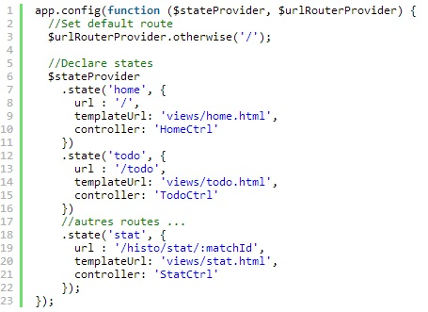
IIX. Application Advancement
2. UI-Router
https://github.com/angular-ui/ui-router/
Ionic use UI-Router for its route gestion
Ui-Router add
Gestion inside view
Multiples views
Directives
ui-sref : for link generation
ui-sref-active : to add class if one state is active
Callbacks onEnter et onExit
$urlRouterProvider.otherwise : default route
$stateProvider : routes definition
.state : view name
url : link to view
templateUrl : link view in your app
Controller : controller associate a view

Slide 44

IIX. Application Advancement
2. Create ion-tabs
Modify the following files
App.js :
add a correct route to display tabs (use templateUrl)
Tabs.html :
add a ion-tab with title and icon
add a ion-nav-view in ion-tab
Ion-tab attributs
Conference
Title : Conferences
Icon : ion-ios7-people
Href : #/tab/conferences
Ion-nav-view : conferences-tab
Agenda
Title : Agenda
Icon : ion-calendar
Href : #/tab/agenda
Ion-nav-view : agenda-tab
Ion-tabs
List Ionic icon : http://ionicons.com/
44/43
Notes:
1. The first idea that one has when it comes to batch processing is that the processing does not need human interaction.
2. Nothing is waiting until processing end, so we say it is not in real-time
3. The processing involves (generaly) a high volume of informations that involve thousands, hundreds of thousands, or millions of data rows or transactions
4. And there may be complex logic or calculations to perform on the datas
5. So, this processing is computationally expensive, and we don't want this cost to be part of our on-line application
6. We apply the same treatement to all of our data, so it is bulk-oriented
7. As soon as we found in this kind of situation, we decided to run as batch process.
8. Later we will see that these characteristics have a strong impact on the approach we have on the treatment of batches

Slide 45
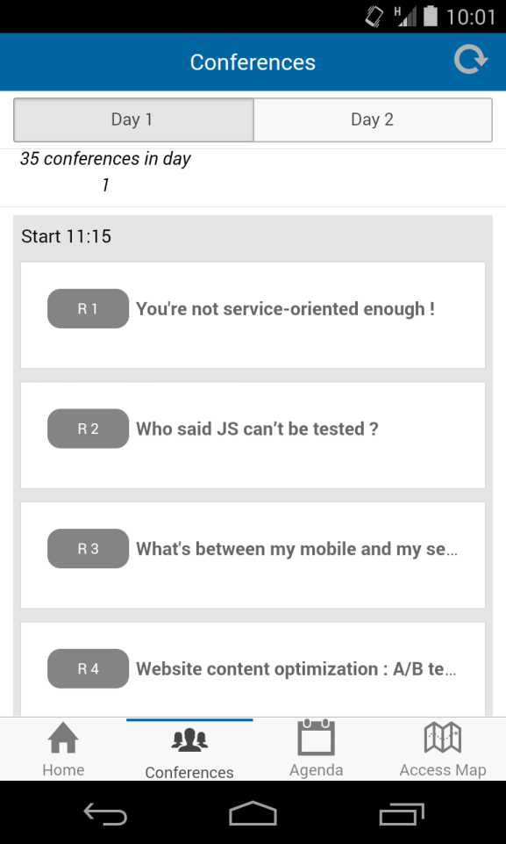
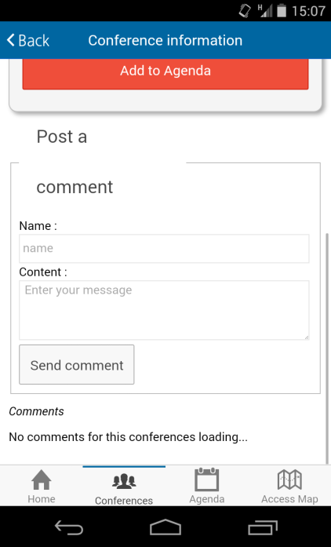
IIX. Application Advancement
3. Implement conferences list with ion-list
Modify the following files
Conferences.html
Add <ion-item> with ng-repeat on conferences ( filtre : | scheduleByConference:itemSchedule:search.day | orderBy:'where‘) and when click on a item, call displayConference(conference) method
Detail_conference.html
Implement a ion-list : for display comments
Ion-list
Post a comment
45/43
Notes:
1. The first idea that one has when it comes to batch processing is that the processing does not need human interaction.
2. Nothing is waiting until processing end, so we say it is not in real-time
3. The processing involves (generaly) a high volume of informations that involve thousands, hundreds of thousands, or millions of data rows or transactions
4. And there may be complex logic or calculations to perform on the datas
5. So, this processing is computationally expensive, and we don't want this cost to be part of our on-line application
6. We apply the same treatement to all of our data, so it is bulk-oriented
7. As soon as we found in this kind of situation, we decided to run as batch process.
8. Later we will see that these characteristics have a strong impact on the approach we have on the treatment of batches

Slide 46
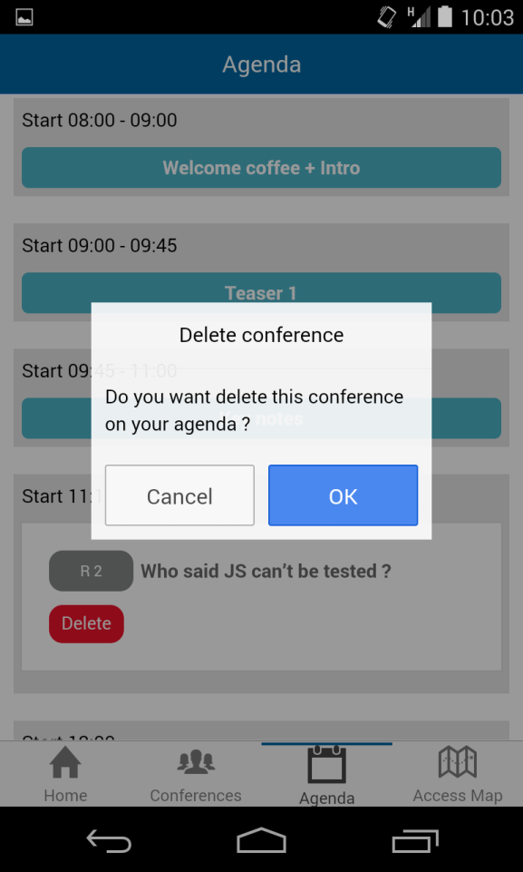
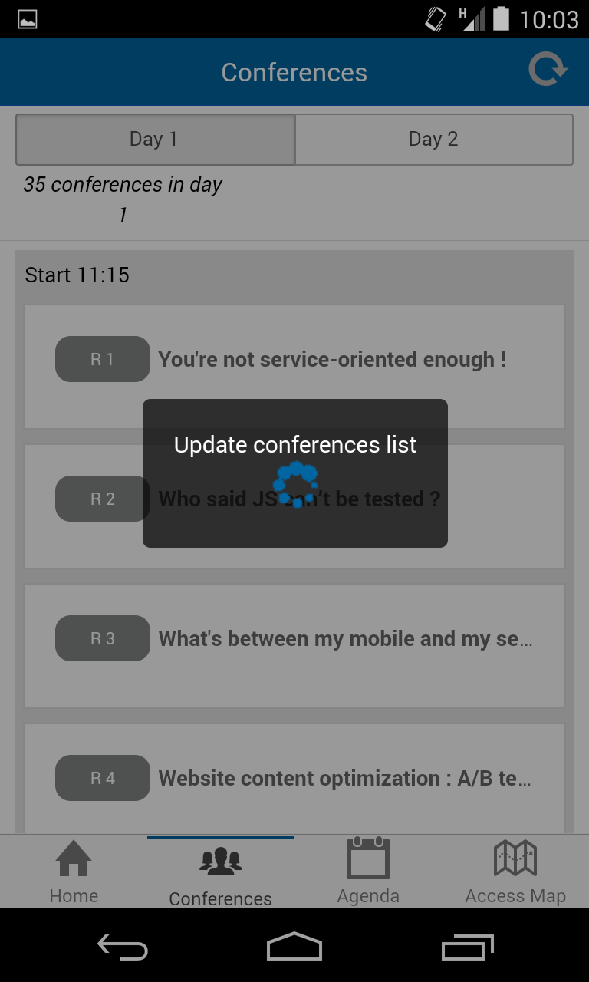
IIX. Application Advancement
4. Implement Popup with IonicPopup
Modify the following files
AgendaController.js
Add IonicPopup add a confirmPopup with ionic
for delete a conference in agenda
ConferencesControllers.js
Add ionic Popup : add a alert when internet is disable on a updateConference method
Add a ionicLoading add a loading for retreive a conference list and don’t forget to hide after success of retreive ( use « atos-loader.gif » in « img » folder).
http://ionicframework.com/docs/api/service/$ionicPopup/
http://ionicframework.com/docs/api/service/$ionicLoading/
IonicConfirm
IonicLoader
46/43
Notes:
1. The first idea that one has when it comes to batch processing is that the processing does not need human interaction.
2. Nothing is waiting until processing end, so we say it is not in real-time
3. The processing involves (generaly) a high volume of informations that involve thousands, hundreds of thousands, or millions of data rows or transactions
4. And there may be complex logic or calculations to perform on the datas
5. So, this processing is computationally expensive, and we don't want this cost to be part of our on-line application
6. We apply the same treatement to all of our data, so it is bulk-oriented
7. As soon as we found in this kind of situation, we decided to run as batch process.
8. Later we will see that these characteristics have a strong impact on the approach we have on the treatment of batches

Slide 47
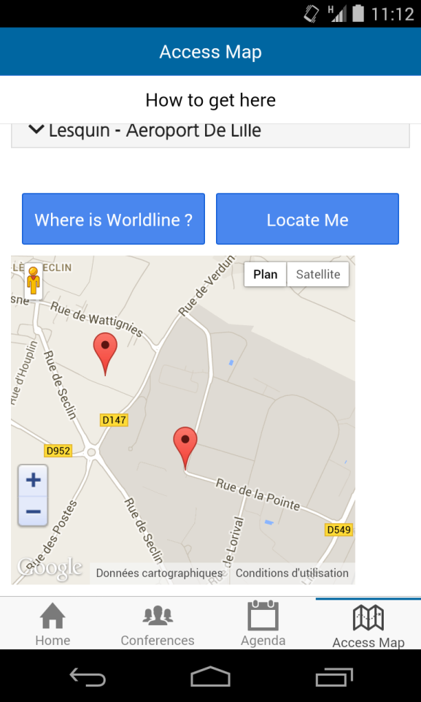

IIX. Application Advancement
5. Integration GPS Plugin
Download and integrate a GPS plugin
Download plugin by Github
Install plugin with .zip if you have a some proxy’s problem
Don’t forget to build for « install » plugin in your app
In AccessController
Implement getMyPosition for update a user currentPosition
Use a apply() to update position on interface
Update map.marker and map.center with a current position
https://github.com/apache/cordova-plugin-geolocation
GPS Plugin
47/43
Notes:
1. The first idea that one has when it comes to batch processing is that the processing does not need human interaction.
2. Nothing is waiting until processing end, so we say it is not in real-time
3. The processing involves (generaly) a high volume of informations that involve thousands, hundreds of thousands, or millions of data rows or transactions
4. And there may be complex logic or calculations to perform on the datas
5. So, this processing is computationally expensive, and we don't want this cost to be part of our on-line application
6. We apply the same treatement to all of our data, so it is bulk-oriented
7. As soon as we found in this kind of situation, we decided to run as batch process.
8. Later we will see that these characteristics have a strong impact on the approach we have on the treatment of batches

Slide 48

IIX. Application Advancement
6. Build on Android
Build your app =)
Build
Test (Real device ou emulator – eclipse …)
Create APK
Sign APK
You can now
Develop an application with Cordova/Ionic
Build and deploy a Cordova App
48/43
Notes:
1. The first idea that one has when it comes to batch processing is that the processing does not need human interaction.
2. Nothing is waiting until processing end, so we say it is not in real-time
3. The processing involves (generaly) a high volume of informations that involve thousands, hundreds of thousands, or millions of data rows or transactions
4. And there may be complex logic or calculations to perform on the datas
5. So, this processing is computationally expensive, and we don't want this cost to be part of our on-line application
6. We apply the same treatement to all of our data, so it is bulk-oriented
7. As soon as we found in this kind of situation, we decided to run as batch process.
8. Later we will see that these characteristics have a strong impact on the approach we have on the treatment of batches

Slide 49


IIX. Conclusion
Hydribe
Low-cost development
Cordova / Phonegap is recommanded for
A showcase Application
A simple application (CRUD)
but
Test on several devices
Add more functionnality
IOS material
increase development costs
49/43

Slide 50
Thanks
For more information please contact:
maxime.gens@worldline.com
Training create by S.D.C.O – Web & Mobile Framework
30/06/2014

